Slide 1
ENHANCED PATIENT CARE AND OPERATIONAL EFFICIENCY uSING DATA ANALYTICS, predictive modelling and machine learning

Slide 2
TEAM MEMBERS
AYYAPPAN A (210701510)
TARUN KUMAR S (210701286)
SUDHARSAN B (210701265)

Slide 3
Abstract :
The healthcare sector faces continuous challenges in providing efficient patient care while optimizing operational processes. In response, this project proposes a comprehensive solution leveraging data analytics, predictive modeling, and machine learning techniques to enhance patient care quality and operational efficiency. The project aims to transition from traditional manual and reactive healthcare systems to a proactive approach that anticipates patient needs and diagnosis of patient diseases.
Key components of the proposed system include the implementation of integrated electronic health records (EHR), advanced data analytics, and predictive modeling algorithms. These technologies enable healthcare providers to analyze patient data in real-time, identify trends, and predict outcomes, thereby facilitating proactive patient care strategies. By leveraging machine learning algorithms for decision support, healthcare providers can make informed clinical decisions based on predictive insights, improving patient outcomes and reducing healthcare costs.

Slide 4
Existing System:
Manual Patient Records: Healthcare facilities rely on manual patient records, which are often paper-based or stored in disparate electronic systems.
Limited Data Analysis: Data analysis is limited and often done manually, making it challenging to derive actionable insights from patient data.
Resource Allocation Challenges: Allocation of resources such as staff, equipment, and facilities is not optimized, leading to inefficiencies and potential bottlenecks in patient care.
Lack of Predictive Capabilities: There is a lack of predictive capabilities to diagnose patient disease, identify potential health risks, and prevent adverse events.

Slide 5
Proposed System:
Integrated Electronic Health Records (EHR):
Implement a centralized electronic health records system to consolidate patient data.
Data Analytics and Predictive Modeling:
Utilize advanced data analytics techniques and predictive modeling algorithms to analyze patient data in real-time.
Identify patterns, trends, and correlations within the data to predict patient outcomes and optimize treatment plans.
Machine Learning for Decision Support:
Develop machine learning algorithms to provide decision support for healthcare providers.
Predict patient diagnoses, treatment responses, and potential complications to guide clinical decision-making.

Slide 6
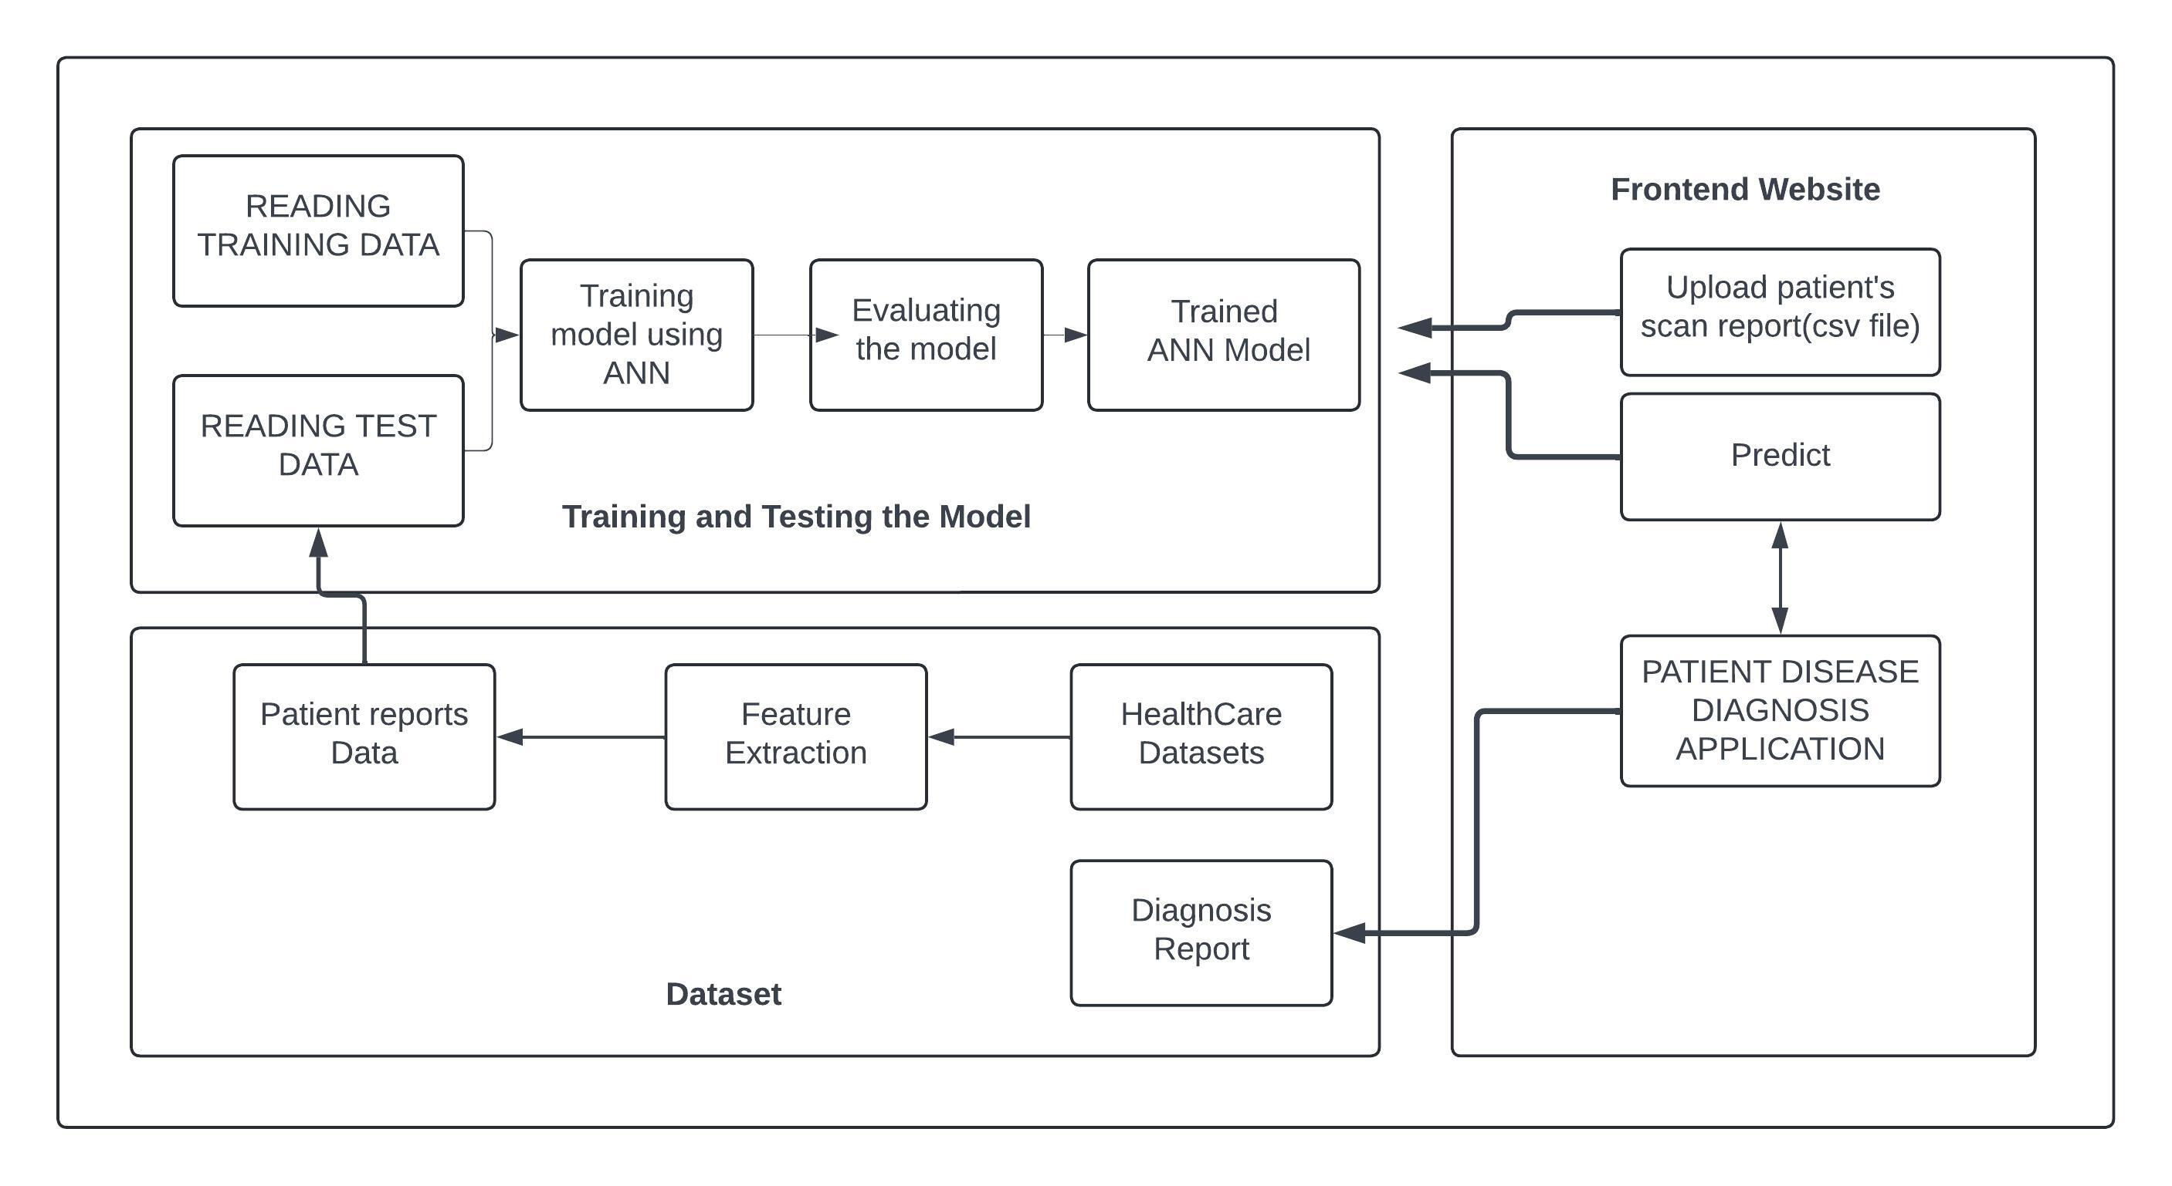
ARCHITECTURE

Slide 7
MODULES :
1. Data Collection Module
Data collection : Handles the collection of patient data, including symptoms, medical history, and any other relevant information.
Imports data from various sources (CSV files, databases) from kaggle and open sources.
Data Validator: Ensures the data is clean and formatted correctly.
2. Data Preprocessing Module
Preprocessing : Prepares the data for training by cleaning, normalizing, and transforming it.
Data Cleaner: Removes or corrects invalid data.
Feature Extractor: Extracts relevant features from raw data.
Data Normalizer: Normalizes the data to a consistent scale.

Slide 8
MODULES :
3. ANN Model Module
Contains the architecture and implementation of the artificial neural network.
Defines the structure of the neural network (layers, nodes, activation functions).
Model Trainer: Handles the training process of the neural network by fitting the data into the ANN model.
Model Evaluator: Evaluates the performance of the model using validation and test data.
4. Prediction Module
Description: Uses the trained model to predict diseases based on new patient data.
Predictor: Takes new patient data and uses the model to make predictions.
Result Interpreter: Interprets the model's output to generate a meaningful diagnosis.

Slide 9
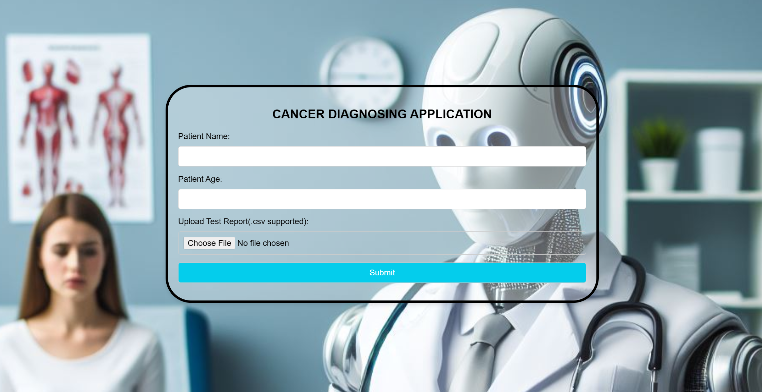
MODULE EXPLANATION
FIG 1.0

Slide 10
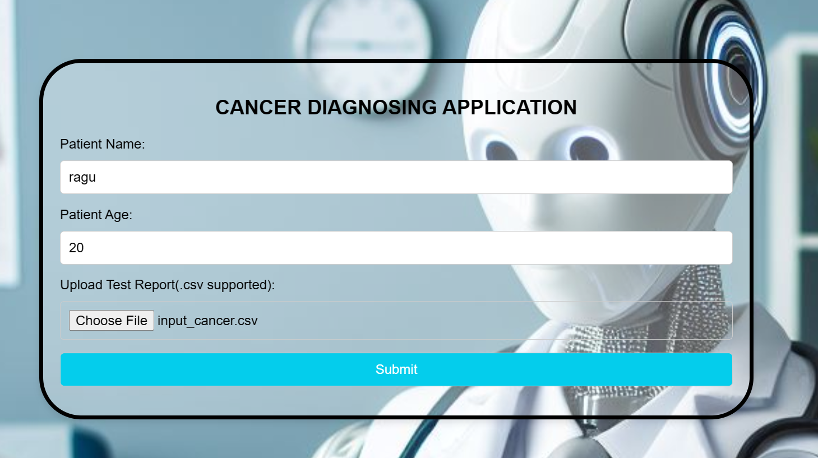
MODULE EXPLANATION
FIG 1.1

Slide 11
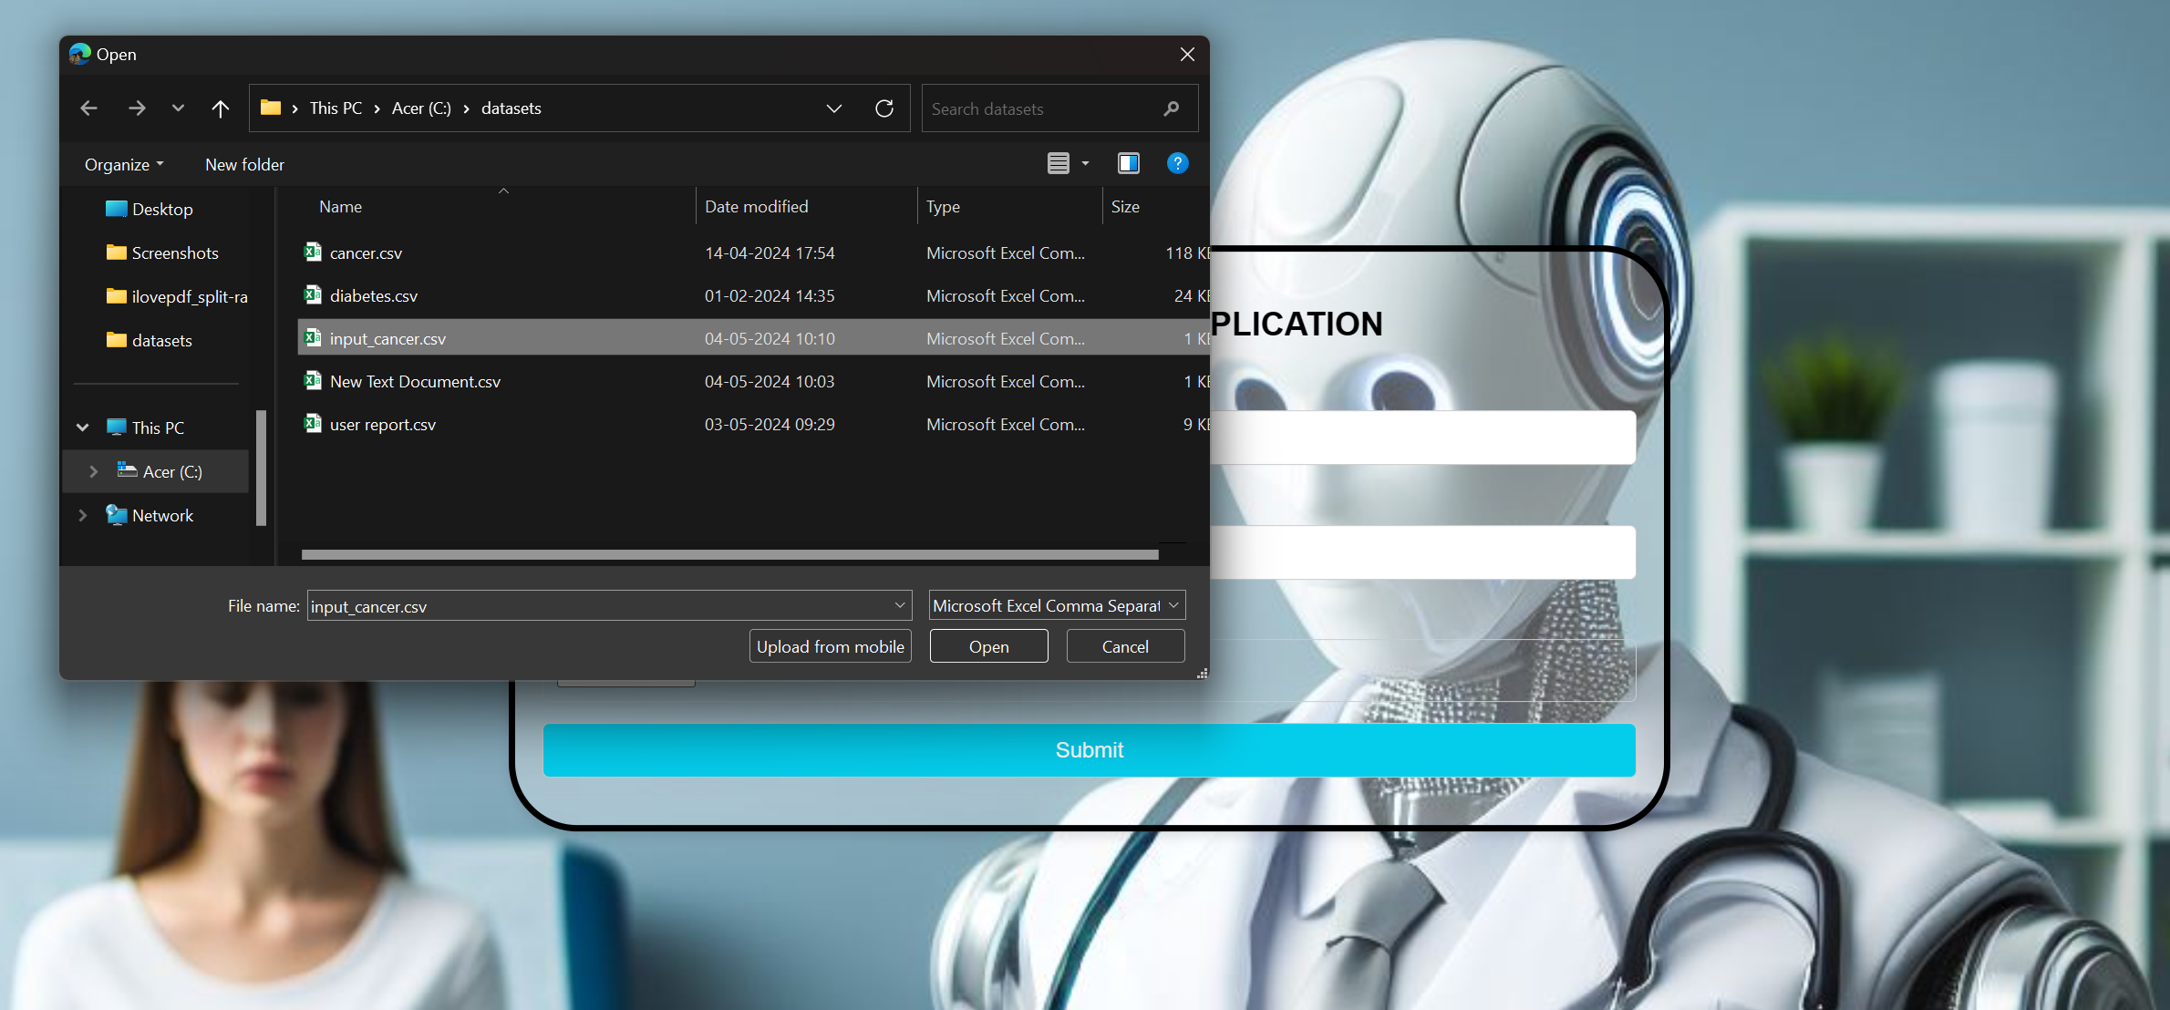
MODULE EXPLANATION
FIG 1.2

Slide 12
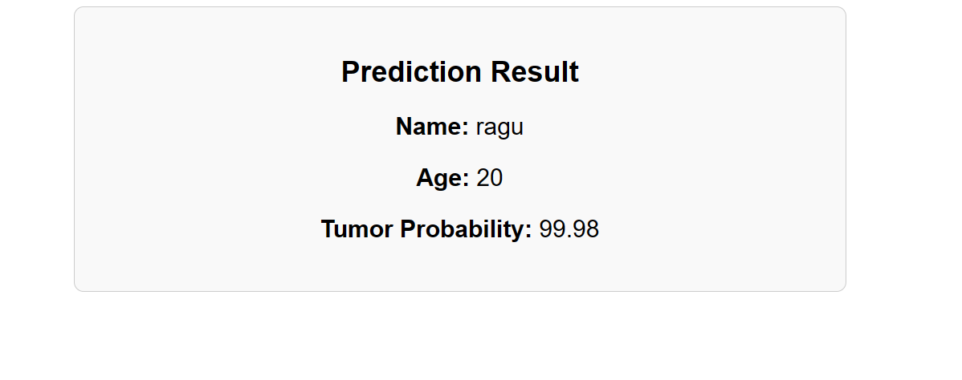
MODULE EXPLANATION
FIG 1.3

Slide 13
RESULT :
The implementation of the Patient Disease Prediction system using an artificial neural network (ANN) demonstrated significant improvements in predicting diseases, thereby enhancing patient care quality and operational efficiency. The system processed patient data, collected through a series of preprocessing steps, including data cleaning, feature engineering, and normalization. The ANN model using sigmoid function, comprising an input layer, two hidden layers, and an output layer, was trained on this preprocessed data and achieved an accuracy of 95% on the test dataset, with a final loss value of 0.41, indicating minimal prediction errors.
The system's predictive capabilities enabled proactive patient care strategies, reducing the time to diagnosis, improving patient outcomes, and leading to significant cost savings by minimizing unnecessary medical tests and procedures. Overall, the project successfully showcased the potential of integrating data analytics and machine learning in healthcare to transition from a reactive to a proactive care model, ultimately enhancing clinical decision-making and operational efficiency.

Slide 14
discussion :
The Patient Disease Prediction project using artificial neural networks (ANN) represents a significant advancement in healthcare by enabling early disease detection and proactive patient management through predictive modeling. The system, trained on data from electronic health records (EHR), achieved an 95% accuracy rate and 0.41 loss value, highlighting its robustness and potential to improve patient outcomes and reduce healthcare costs. Real-time predictions facilitate informed clinical decision-making, marking a shift from reactive to proactive care.
However, challenges such as ensuring data diversity, expanding to multi-disease prediction, integrating explainable AI for transparency, and enhancing data privacy and security remain. Future enhancements, including incorporating IoT data and personalized medicine approaches, will further augment the system's utility, making it a transformative tool in modern healthcare.

Slide 15
conclusion :
In conclusion, the project on enhanced patient care and operational efficiency in healthcare using data analytics, predictive modelling, and machine learning demonstrates significant potential in transforming healthcare delivery. By leveraging advanced machine learning techniques and predictive models, the system accurately forecasts patient outcomes, identifies high-risk individuals, and personalizes treatment plans, thereby improving patient care and reducing adverse events. The integration of AI-driven diagnostic tools allows for preliminary patient diagnosis without direct doctor involvement, enhancing diagnostic speed and accuracy.
Additionally, the optimization of resource allocation and operational workflows contributes to increased efficiency and reduced wait times. This project marks a substantial advancement in empowering healthcare providers with the tools and insights necessary to deliver high-quality care and achieve operational excellence.

Slide 16
future enhancements
Expanding Dataset: Incorporate more diverse and larger datasets from various sources to improve the model's generalizability and accuracy.
Multi-Disease Prediction: Extend the system to predict multiple diseases simultaneously, rather than focusing on a single disease.
Integration with IoT Devices: Incorporate data from wearable devices and other IoT medical devices for real-time health monitoring and prediction.
Personalized Medicine: Develop capabilities for personalized disease prediction by considering individual patient histories, genetics, and lifestyle factors.
User Feedback Loop: Create a feedback loop where predictions are validated and corrected based on actual patient outcomes, allowing the model to continuously learn and improve.

